Slide 1


Engineering
Invincible
Sarvesh Singh, BTech Mechanical
Abhijit Dalai, BTech Chemical
Naman Aggarwal, BTech Mechanical
Naina, BTech Mechanical

Slide 2

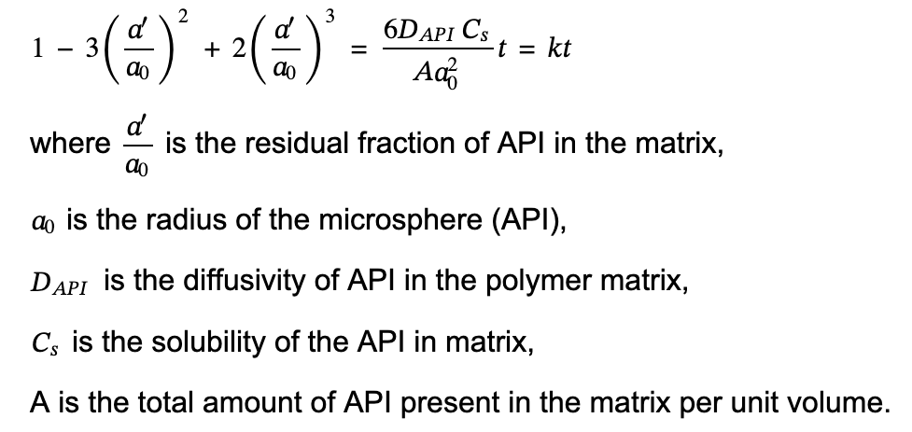
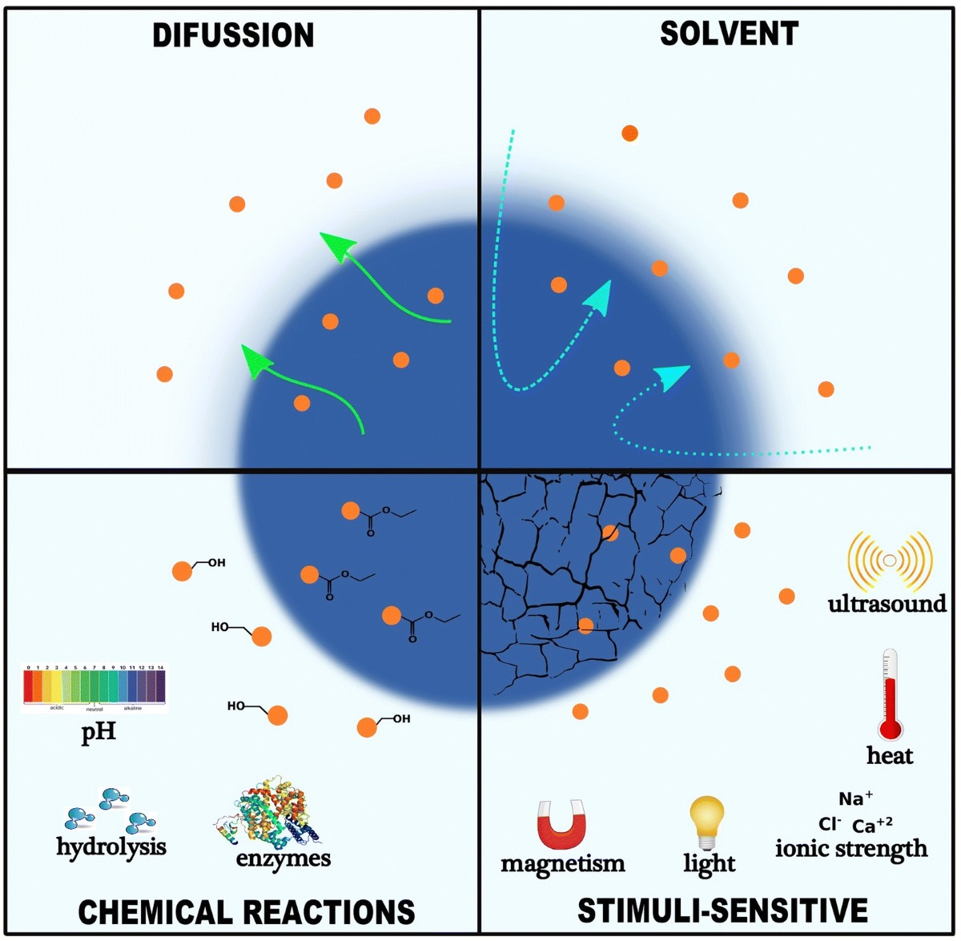
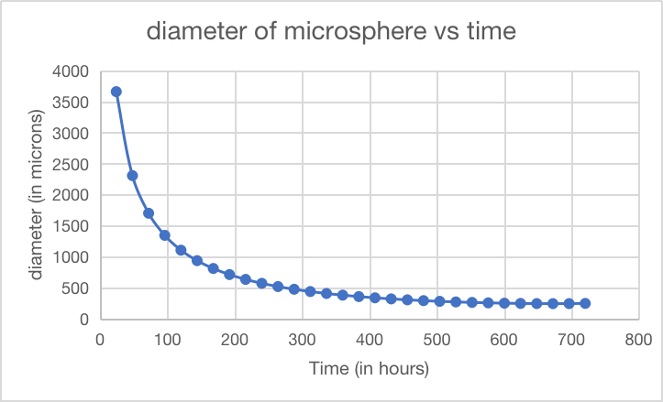
Higuchi Model of Drug Release
Objective
Reference
Determine diameter of microspheres for given daily release target of API
Effect of the diffusivity on the time taken for the entire drug release following Higuchi Model
• Assuming initial concentration is much greater than solubility of drug in matrix (A >> Cs), the Higuchi model for spherical systems is reduced to,
If diffusivity D is reduced to ¼ then time required to release same amount of API increase by factor of 1/D
Rapid
Effect of shape of microsphere in API's release
Spherical
Non - spherical
Uniform diffusion rate
Lower Surface area to Volume Ratio leading to slower and controlled release
Slow and sustained release profile
Lower surface tension, contributing to stability and uniformity
More uniform particle size, leading to consistent drug release and enhanced stability
Non-Uniform and anisotropic diffusion rate
Higher surface area to volume ratio leading to accelerating API release causing a burst effect
Rapid release rate, leading to Complex profiles
Higher surface tension, which may result in irregular behaviors and instability
Irregular particle size distribution , leading to variability in drug release and potential instability
• Assuming the value of Cs to be very low, we consider 0.01 g/cm³ for Cs and 277.5 × 10⁶ g/cm³ for A. The diameter of the microsphere (API) released at different time intervals is estimated using the Higuchi Model equation.
• Diameter of microspheres to achieve daily release targets = 597.47µm

Slide 3
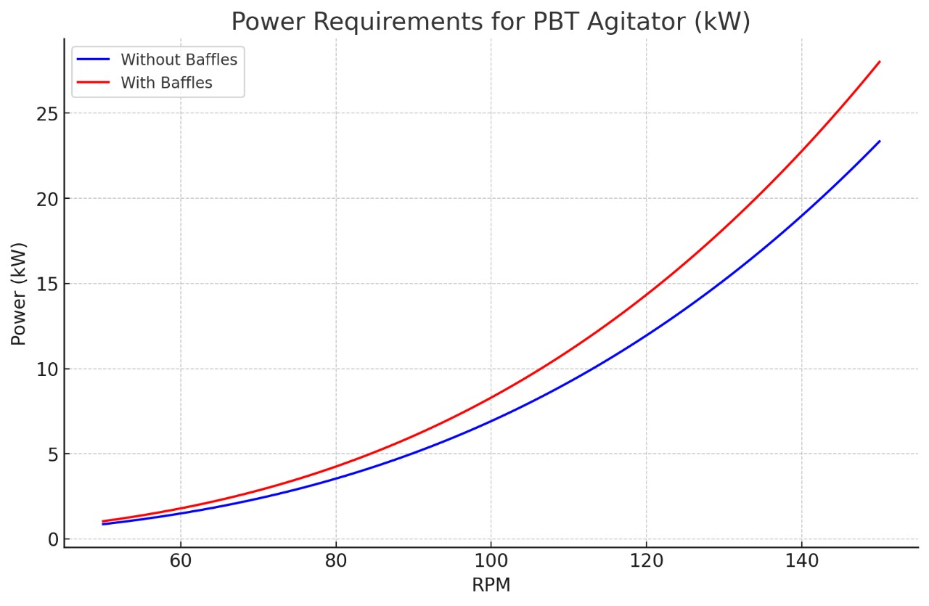
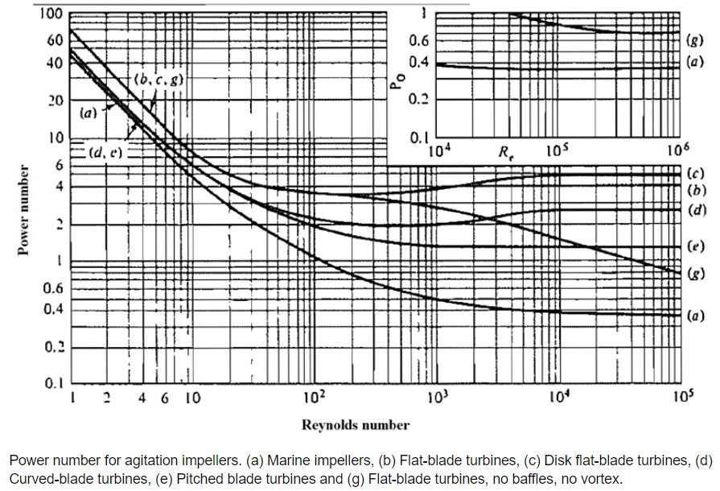
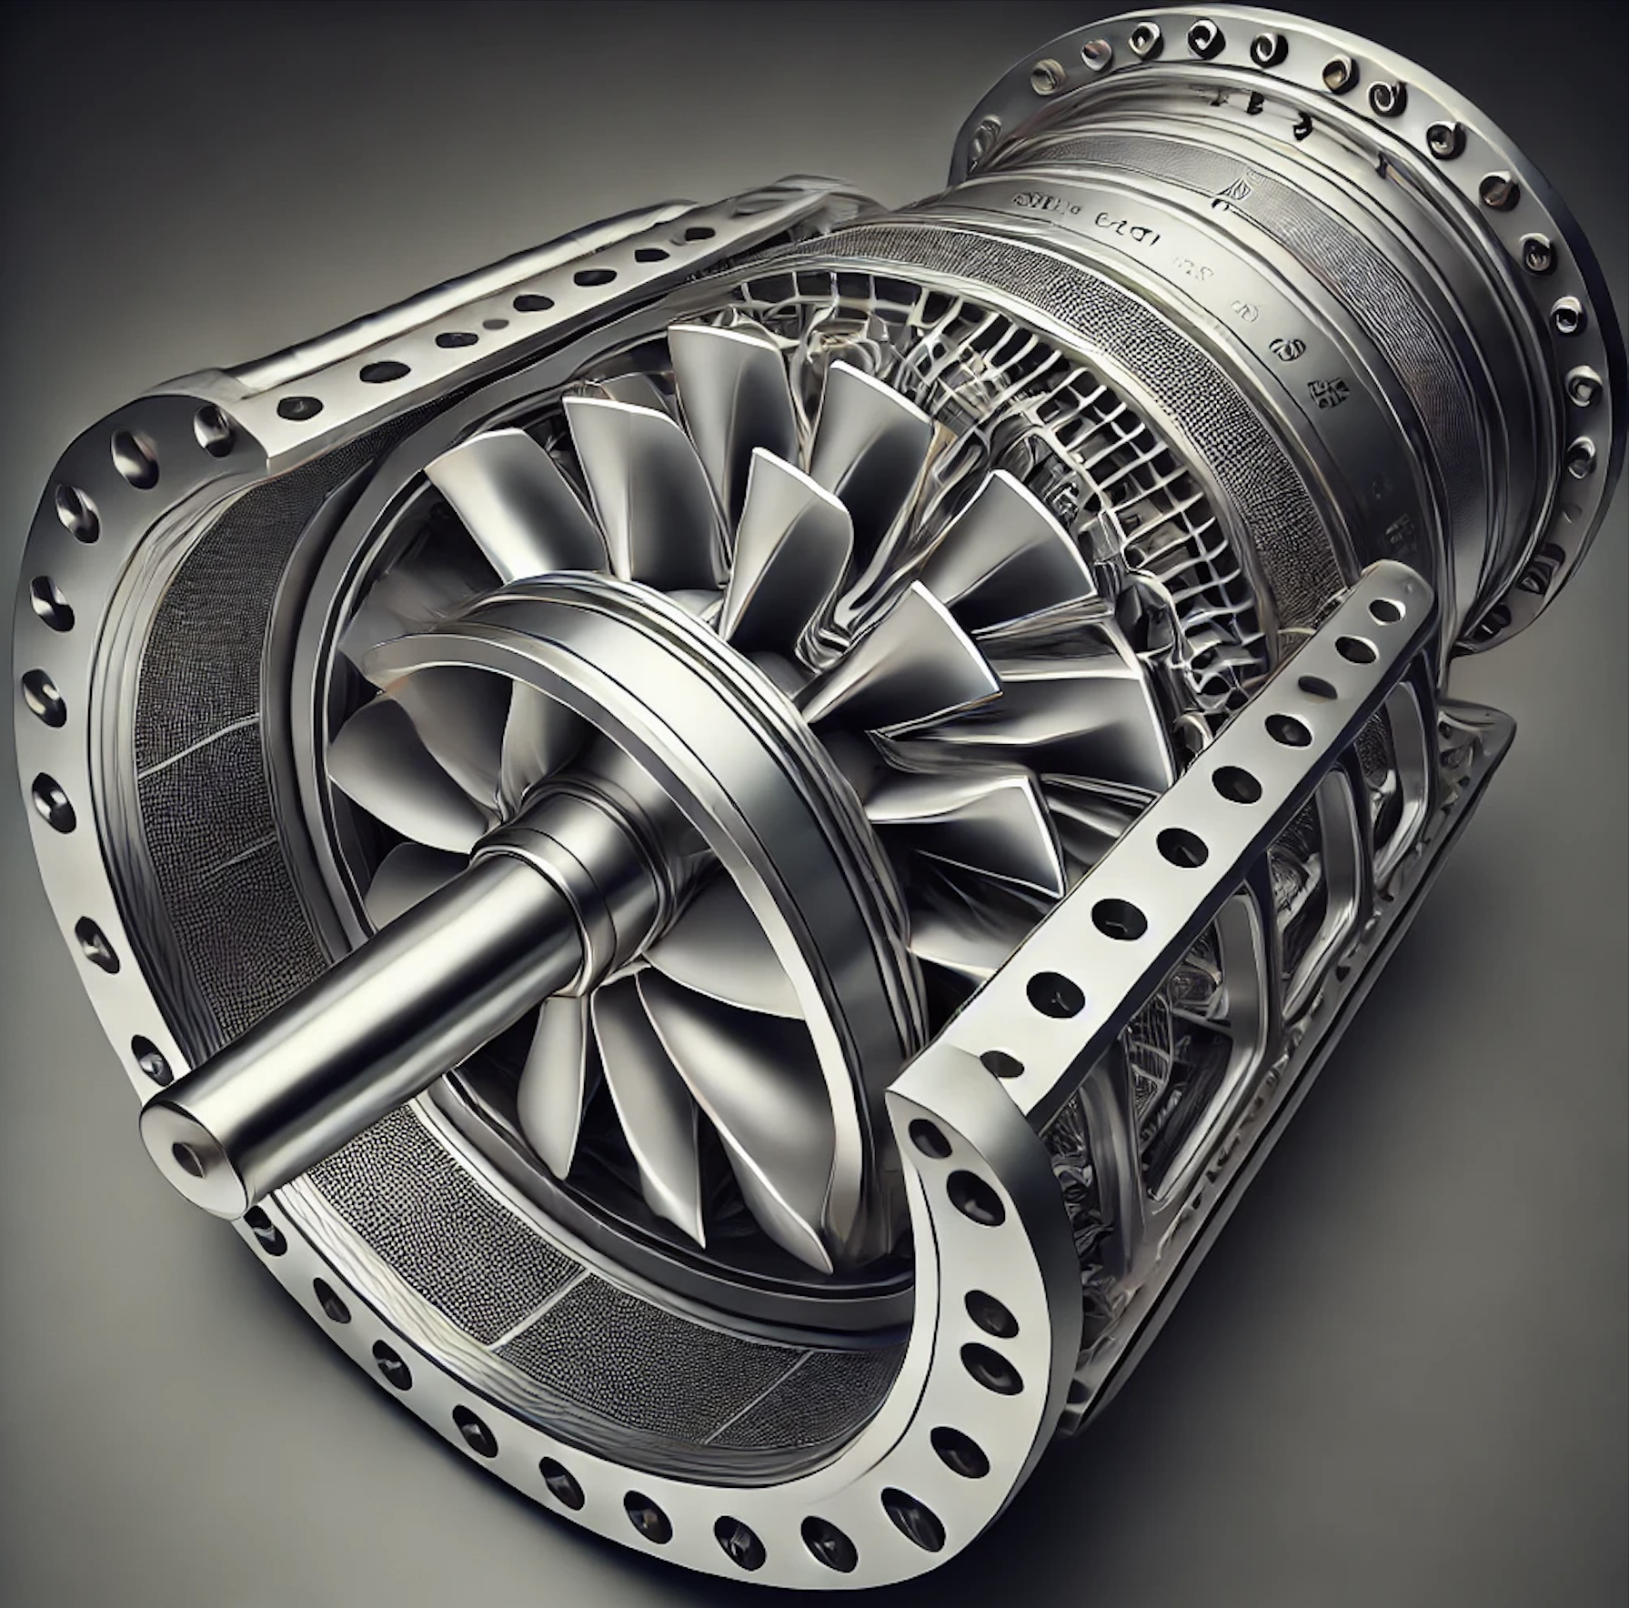
Pitch Blade Turbine (PBT)
Calculating Reynolds Number
Reference 1
Reference 2
Reference 3
Where N = 100 rpm = 100/60 rps = 1.67 rps
= 1667 (<2000) So the flow is laminar
Power Calculation for Pitch Blade Turbine
Estimating power required for PBT agitator,
Assuming Np to be 1.27 from the graph shown below
Calculating we get P approximately as 5.91 kW
Since, the motor and pump has an efficiency around 85%.
So, total power required= P/efficiency
Giving a value approximately equal to 6.96 kW
Impact of Baffles on Mixing Efficiency and Power Requirement
Baffles disrupt flow patterns, enhancing fluid circulation and mixing uniformity.
Baffles will introduce large pressure drop and increase power consumption significantly about 15-20 percent.
For the calculated power requirement of 5.91 kW, the adjusted power with baffles is approximately 7.09 kW (about 1.2 times growth).
Regular control and checkups can be ensured so that mixing efficiency is not compromised even after installing motors with such high power.
The value of N required for generating 7.09 kW power will come out to be 1.523 and actual power required will be nearly 8.35 kW.

Slide 4
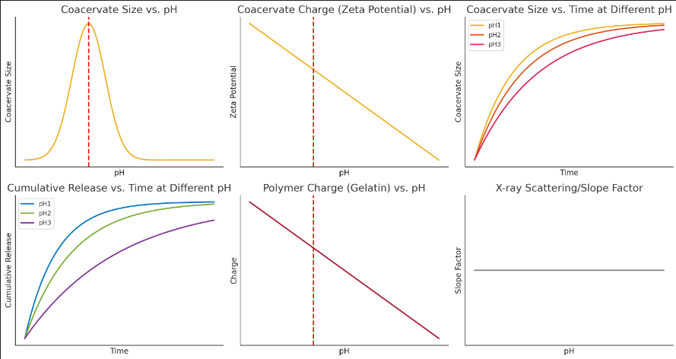
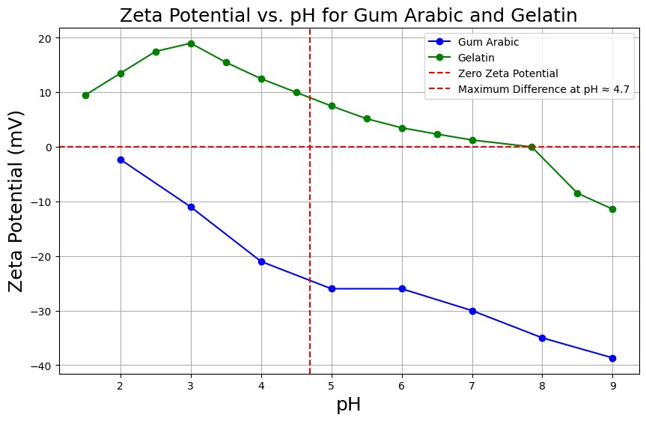
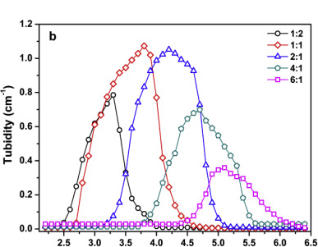
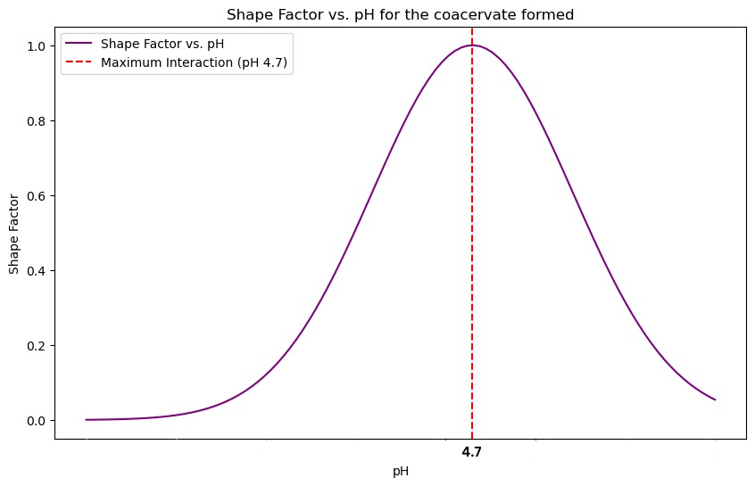
Influence of pH change in coacervation
Reference
Experiment Design:
Investigating the Effect of pH on Coacervation & Coacervate Stability
Objective:
To assess the impact of varying pH levels on the coacervation process and the stability of the coacervate phase, focusing on its implications for drug delivery applications.
Methodology
Sample Preparation:
Prepare a polymer-surfactant mixture (e.g., gelatin and gum Arabic) that undergoes coacervation.
Prepare multiple solutions of the mixture, each adjusted to a different pH level (e.g., pH 3, 5, 7, 9, 11) using appropriate buffers.
Coacervation Induction:
Induce coacervation in each pH-adjusted solution by gradually adjusting the temperature or adding a non-solvent.
Record the onset of coacervation, including conditions for phase separation.
Coacervate Stability Analysis:
Analyze the stability of formed coacervate phases by measuring size, shape factor, zeta potential and cumulative release over time using light scattering, microscopy, and turbidity measurements.
Compare the stability across different pH levels over a set period.
Drug Encapsulation Efficiency:
Incorporate a model drug into coacervation process at each pH level.
Evaluate drug loading efficiency and release profile using UV-Vis spectroscopy or HPLC.
Expected Results
The experiment is likely to identify an optimal pH range, where coacervation is most efficient, likely near polymer's isoelectric point. Coacervates formed at this pH are expected to be more stable, with higher drug encapsulation efficiency and a controlled release profile. Coacervates formed at extreme pH levels are less stable, less effective for drug delivery.
Implications
Understanding the pH-dependent behaviour of coacervates allows for designing drug delivery systems tailored for targeted and controlled release, enhancing therapeutic effectiveness and offering potential applications in areas such as cancer treatment where pH-sensitive drug release is advantageous.

Slide 5
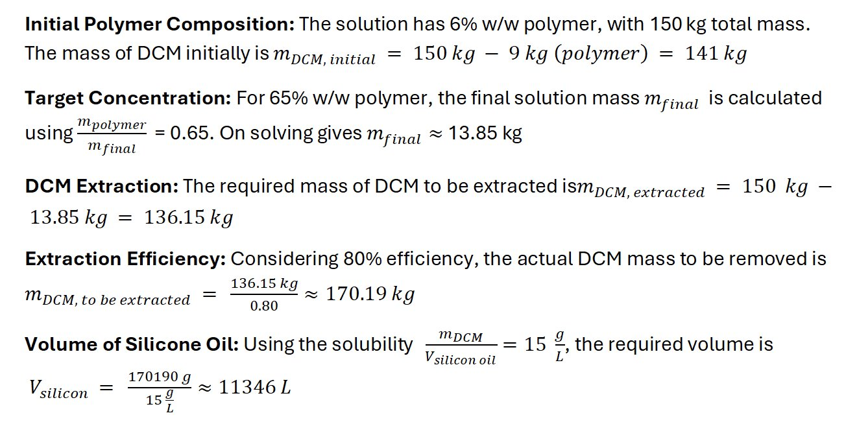
Solvent Extraction in Polymer Coacervation
DCM Extraction and Volume of Silicone Oil
Reference 1
Risks, Mitigation and Alternatives
Reference 2
Risks: DCM in pharmaceutical manufacturing poses risk health, including toxicity and environmental(air and groundwater pollution) while risk that silicone oil pose include contamination and challenges in processing due to its viscosity.
Mitigation: Using enclosed systems, proper ventilated channels, monitoring for residues and control on temperature can be possible mitigation steps.
Alternatives: Ethyl Acetate: Safer but flammable.
MEK: Effective, less toxic and requires careful handling.
Propylene Carbonate: Environmentally friendly and limited by solubility.
Silicone Oil in Coacervation
Stabilization: Reduces interfacial tension which enhances phase separation. Higher addition rates improve stabilization but can increase viscosity and complicate extraction.
Impact: Viscosity>1000cP slows down separation and demand for stronger agitation.
Optimization: Adjusting silicone oil concentration and addition rate, managing temperature(20-60 °C) and usage of additives can enhance separation and extraction.
Temperature variations (+/-5 degree Celsius) Impact
DCM in Silicone oil-
Higher temperature enhances its solubility, improving phase behavior and extraction consistency.
Excessive temperatures accelerate DCM evaporation, reducing solvent availability causing incomplete extraction which further impacts product potency.
API in ethanol-
Elevated temperature increases the solubility of API in ethanol, improving extraction efficiency and uniformity.
Increased temperature raises ethanol volatility, reducing extraction effectiveness, and potentially affecting dosage accuracy.
Role of Agitators and Agitation
Role of Agitation:
Consistent agitation prevents the formation of hotspots, ensuring uniformity in distribution. This is crucial in achieving consistent particle sizes to avoid clumping.
Proper agitation balances the coacervation process, sensitive to surface tension changes, aiding in effective phase separation and uneven particle formation.
Role of Agitators:
Turbine impellers create high shear forces, promoting even mixing and breaking down clumps, leading to smaller particle sizes (<100 µm).
Paddle agitators maintain uniformity in larger particles(500-1000 µm).
Surface tension can be manipulated by controlling agitation speed(300-600 RPM) and optimizing baffle placement thus ensuring consistent particle size distribution.

